Slide 1
Credit card Management System
Name: Penthala Sahithi(I-176)
TAP INTERN 2024

Slide 2
Introduction:
In today's fast-paced world, managing multiple credit cards and tracking expenses can be a daunting task. That's where our Credit Card Management System comes in!
It provides a user-friendly platform for users to add, remove, and manage their credit cards, categorize transactions, set spending limits, and receive alerts for critical credit card activities.
Our system features advanced search and filter options, making tracking transactions effortless.
With our system, users can easily manage their finances in one place, on one dashboard. The platform is hassle-free and targeted towards consumer's credit card needs.
Say goodbye to unorganisation, missed payments, and overspending with our Credit Card Management System.

Slide 3
Objectives and goals:
Allow users to manage multiple credit card accounts and track expenses on one platform.
1
Create a user-friendly dashboard that displays a summary of all credit card account activities and advanced search and filter options for specific transactions.
2
Enable users to set spending limits for their credit cards and receive notifications to stay within their limits.
3
Allow users to categorize transactions for easier expense tracking and generate reports highlighting spending patterns and trends.
4
Create a user-friendly, streamlined, and efficient system that makes it effortless for individuals and businesses to manage their financial activities.
5

Slide 4
Problem Statement:
Many individuals find it challenging to manage their credit card accounts efficiently, which can lead to missed payments, exceeding credit limits, and potential financial difficulty. There is a need for a comprehensive credit card management system that provides a user-friendly dashboard, transaction history, expense tracking, payment reminders, and advanced search and filter options to help users stay on top of their finances. Such a system would enable users to add and remove credit cards, set credit limits, and track their spending over time. Moreover, it would allow them to export transaction data in a format of their choice and update their profile information and notification preferences as required. By providing such a platform, users can better manage their credit cards and reduce the risks of financial problems.

Slide 5
Why flask?
Flask was likely chosen as the web framework for this credit card management system due to its simplicity, flexibility, and scalability.
Flask is a lightweight web framework that allows developers to build web applications quickly and easily. It does not have pre-defined project structures that you have to follow, giving developers more flexibility in how they structure their projects.
Flask also offers various extensions and libraries that can be used to add additional functionality to the web application, enabling developers to scale the application as required. Additionally, Flask integrates well with Python, allowing developers to take advantage of all the Python libraries and tools available for building web applications.
Overall, Flask is a popular choice for building web applications and is well-suited for building web applications with moderate complexity, such as this credit card management system.

Slide 6
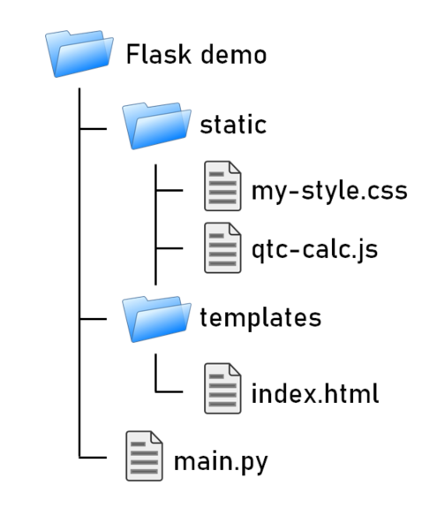
Project Structure:
In the Flask framework, all the HTML files will be stored inside the "templates" folder, and all CSS, JavaScript, and image files will be stored inside the "static" folder.
The Python file will contain the routing code for the web application, which includes all the functions necessary to handle user requests and render the appropriate HTML templates.
Additionally, the Python file will include configuration settings for the Flask application, such as the database connection details, secret key, and other important settings.

Slide 7
Why specific technologies were used?
HTML and CSS are widely used for frontend development and were chosen for their ability to create visually appealing and user-friendly web pages.
Flask was chosen for its ability to build web applications quickly and easily, offering flexibility and scalability.
MongoDB's NoSQL database was chosen for its ability to handle large amounts of potentially unstructured data, making it ideal for a credit card management system.
Combined, these technologies offer a strong foundation for building a custom and feature-rich credit card management system that can be easily scaled as needed to meet new requirements and accommodate user growth

Slide 8

Features implemented:
Add Credit Cards: Users can add credit cards to their accounts which are then securely stored. This feature helps users keep track of different payment schedules and avoid missing payments on credit card bills.
Delete Credit Cards: Users can delete credit cards from their account if they no longer need them. This feature enables users to keep their account up-to-date and avoid confusion.
View Recent Transactions: Users can view recent transactions made with their credit cards. This feature helps users keep track of their spending and detect any fraudulent activity.
Analyze Spending Patterns: Users can view their spending patterns through pie charts and bar graphs. This feature helps users understand where they are spending their money and make informed decisions on how to manage their budgets.
Transaction History: Users can view the transaction history associated with each credit card. This feature allows users to track their spending over time and identify trends.
Filter Transactions: Users can filter transaction data based on bank names and spending categories. This feature enables users to identify areas where they may be overspending and make changes to their spending habits.

Slide 9
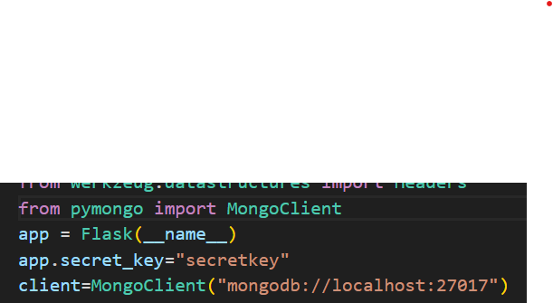
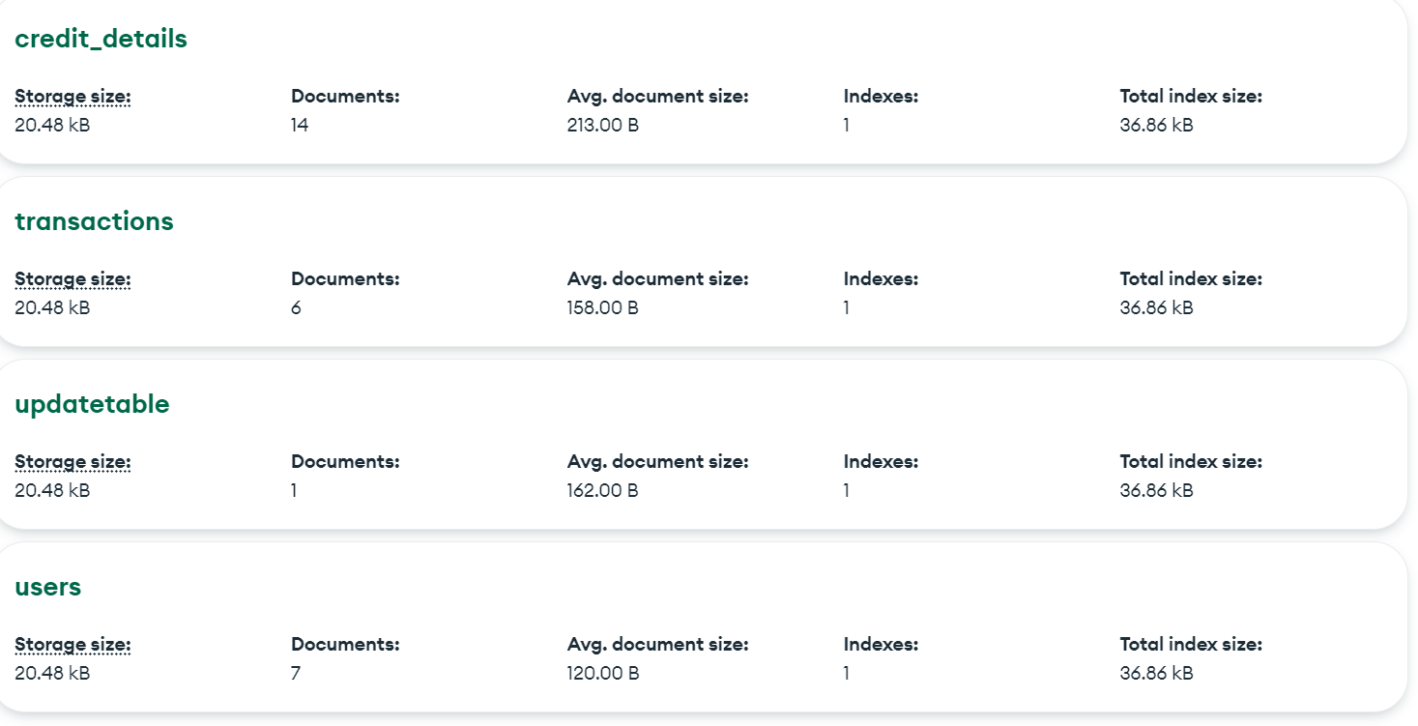
Database integration:
Data is stored and retrieved from MongoDB as JSON-like documents in collections, which allows for flexible and scalable database design.
MongoDB Query Language (MQL) is used when retrieving data from MongoDB, which supports complex query operations.
MongoDB's schema design is flexible and based on the idea of embedding related data together or referencing documents that belong together.
MongoDB handles migrations through versioning, where new versions of the schema are created as changes are made, enabling data to be current and available for use by the application.
MongoDB supports a wide range of data types, including geospatial data types, making it well-suited for a range of applications where data is not strictly structured.

Slide 10
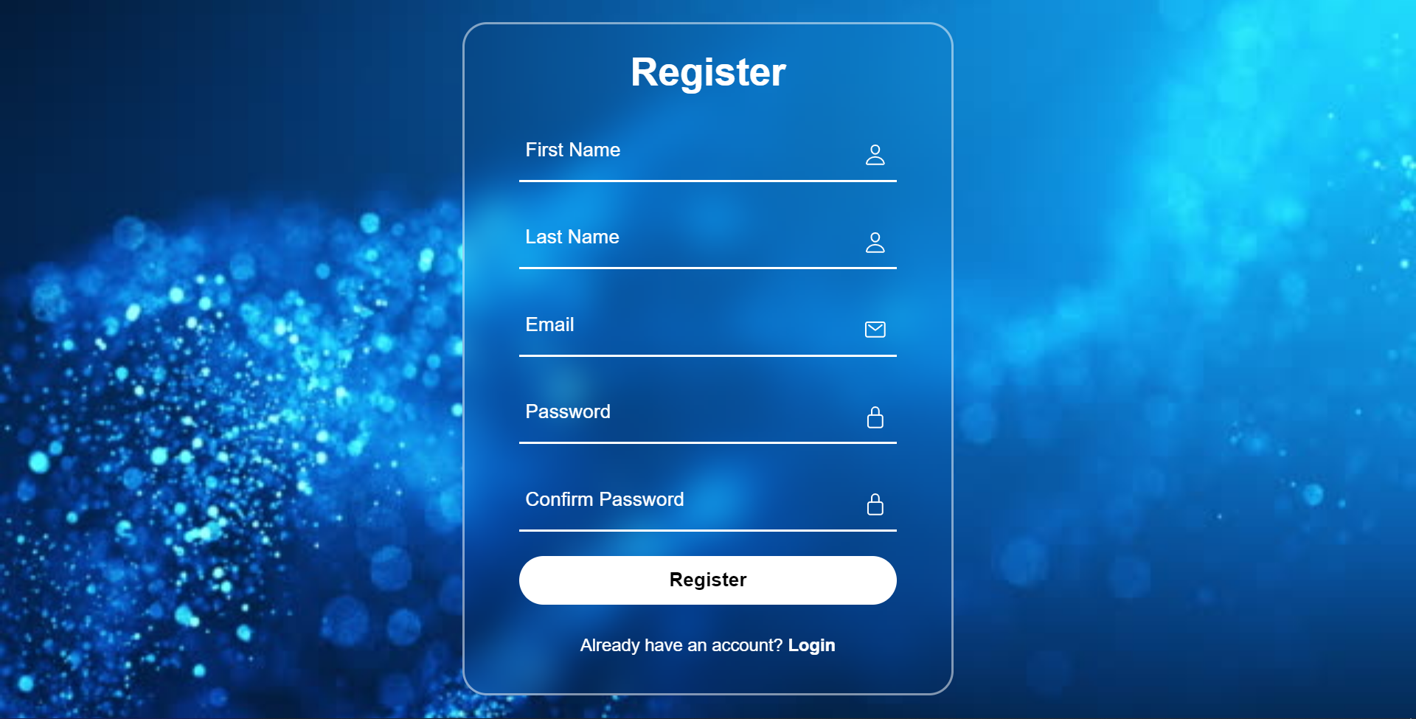
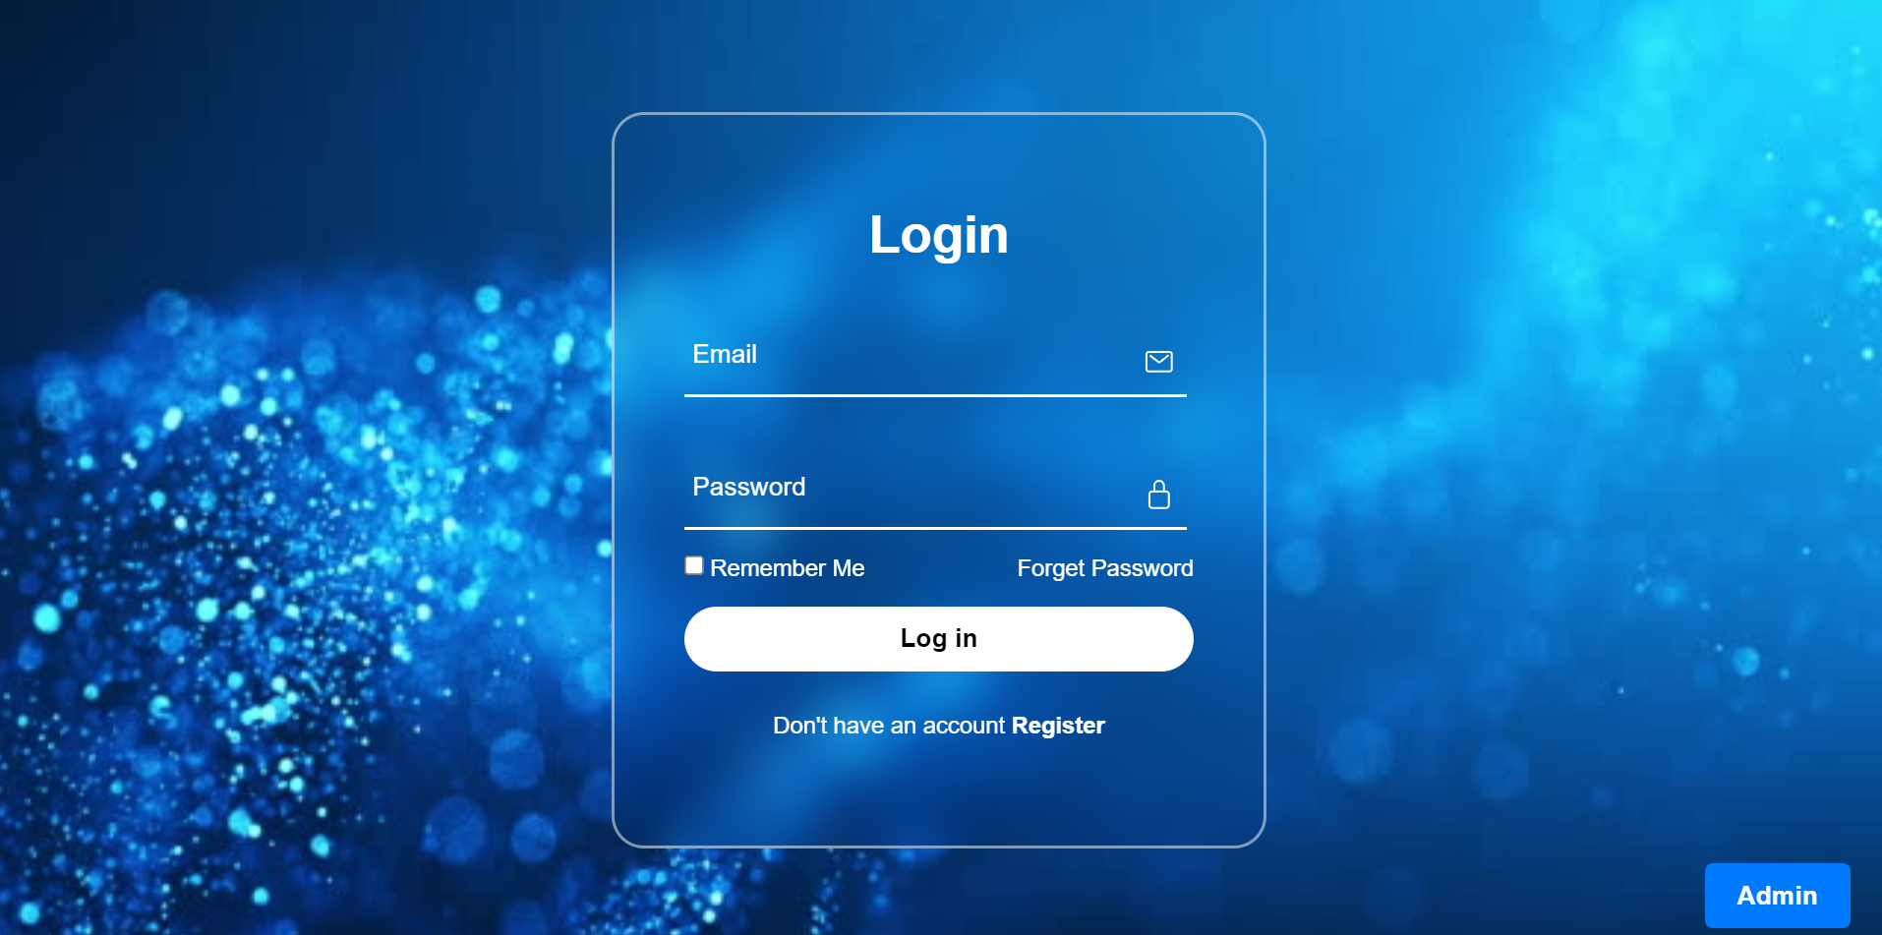
UserInterface

Slide 11
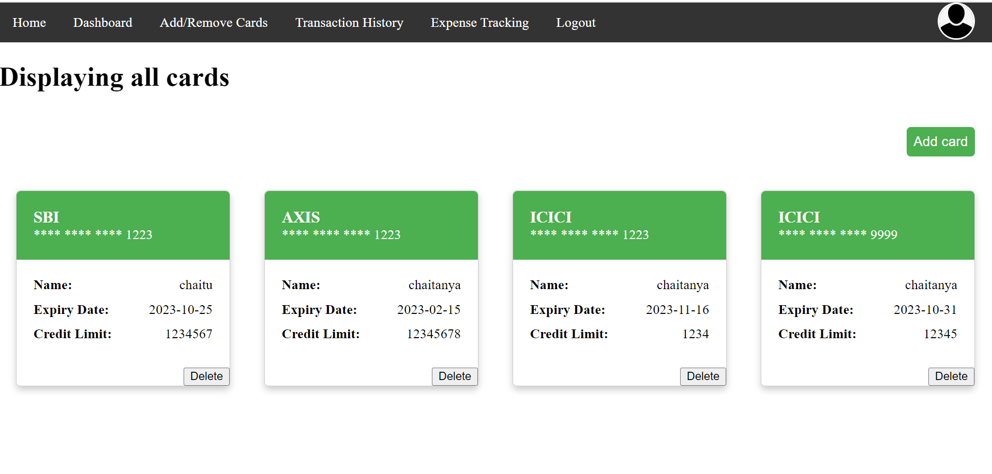
UserInterface

Slide 12
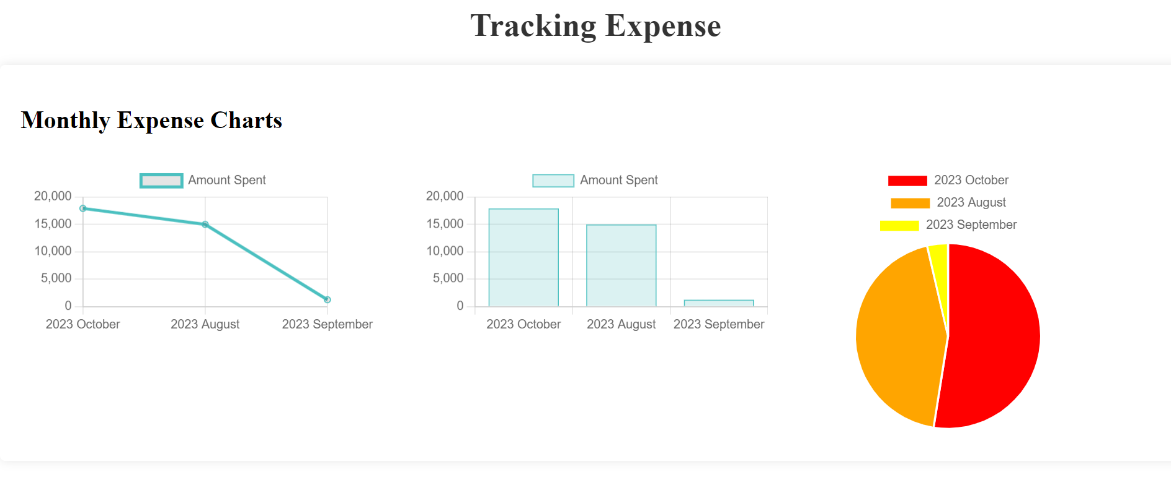
UserInterface

Slide 13
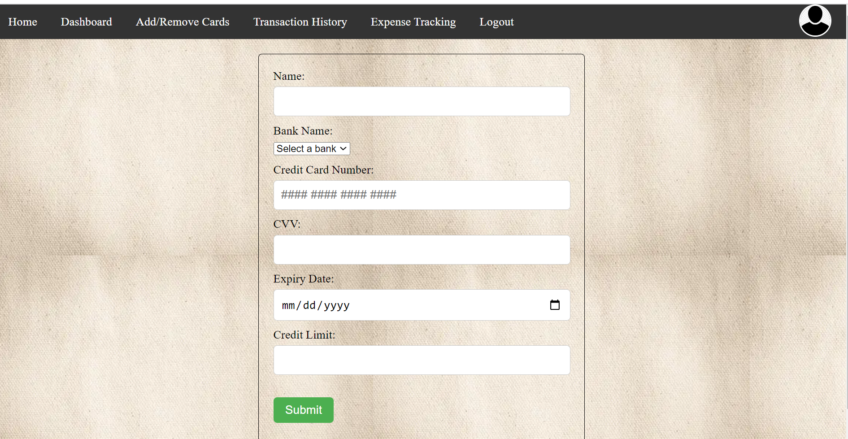
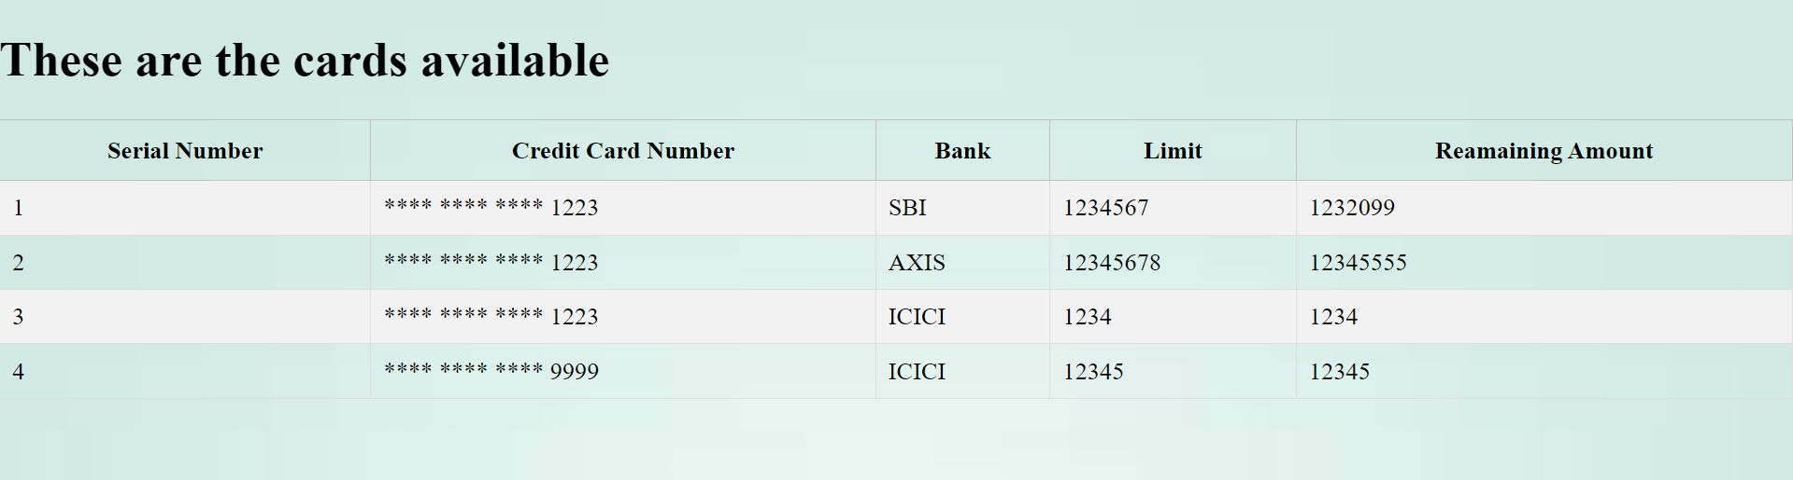
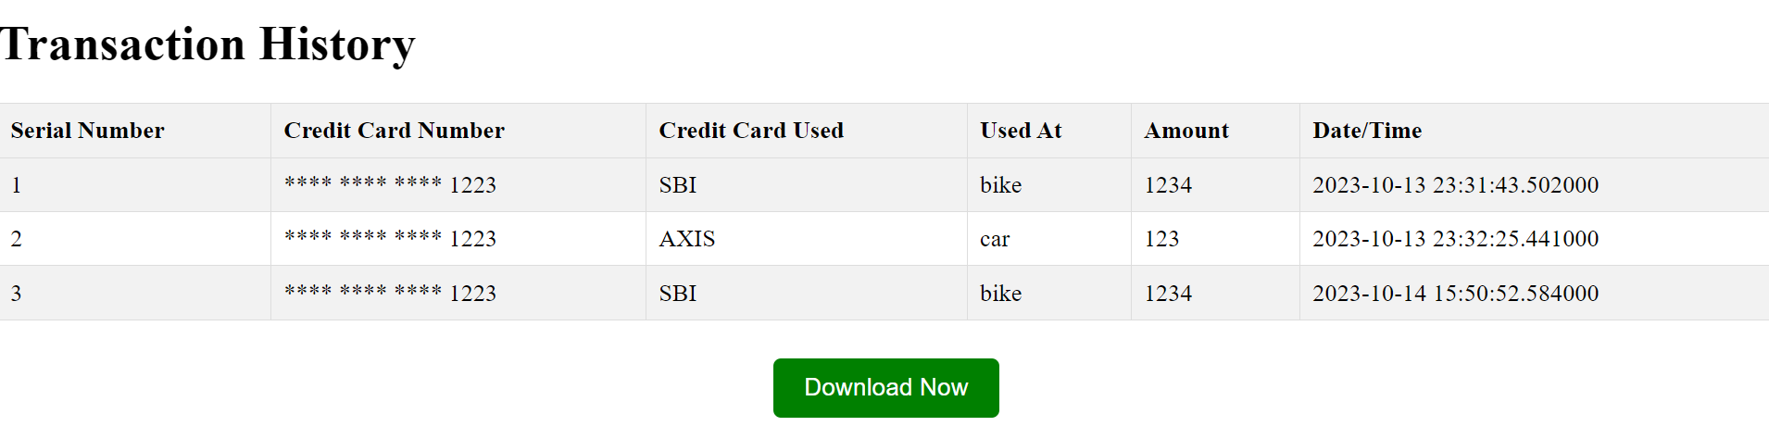
UserInterface

Slide 14
Challenges faced:
Adding a notification system to a credit card management system can present a challenge due to the complexity of implementing such a feature and ensuring it works smoothly across different devices and platforms.
Developing a comprehensive credit card management system can be complex, requiring integration with multiple payment gateways and financial institutions, and adherence to various data security and compliance regulations, making it essential to have experienced developers and robust testing procedures.
Future Scope:
Integrating rewards management systems into the credit card management system. This feature can enable users to view their rewards balances, redeem earned rewards, and monitor their reward activity, making it easier for them to capitalize on the rewards offered by their credit cards.

Slide 15
Thank You

